Slide 1

Consuming a REST Service
Reynaldo Monares
Sr. Mobile App Developer at Pangga Mobile Technologies

Slide 2
What is REST?
REST stands for Representational State Transfer.
Representational State Transfer (REST) is an architectural style for building web services.
REST requests are made over HTTP using the same HTTP verbs that web browsers use to retrieve web pages and to send data to servers.

Slide 3
HTTP Verbs
GET – this operation is used to retrieve data from the web service.
POST – this operation is used to create a new item of data on the web service.
PUT – this operation is used to update an item of data on the web service.
PATCH – this operation is used to update an item of data on the web service by describing a set of instructions about how the item should be modified. This verb is not used in the sample application.
DELETE – this operation is used to delete an item of data on the web service.

Slide 4
What is REST?
Web service APIs that adhere to REST are called RESTful APIs, and are defined using:
A base URI.
HTTP methods, such as GET, POST, PUT, PATCH, or DELETE.
A media type for the data, such as JavaScript Object Notation (JSON).

Slide 6
Effects?
Effects allow the native controls on each platform to be customized, and are typically used for small styling changes

Slide 7
Custom Renderers?
Xamarin.Forms user interfaces are rendered using the native controls of the target platform, allowing Xamarin.Forms applications to retain the appropriate look and feel for each platform. Custom Renderers let developers override this process to customize the appearance and behavior of Xamarin.Forms controls on each platform.

Slide 8
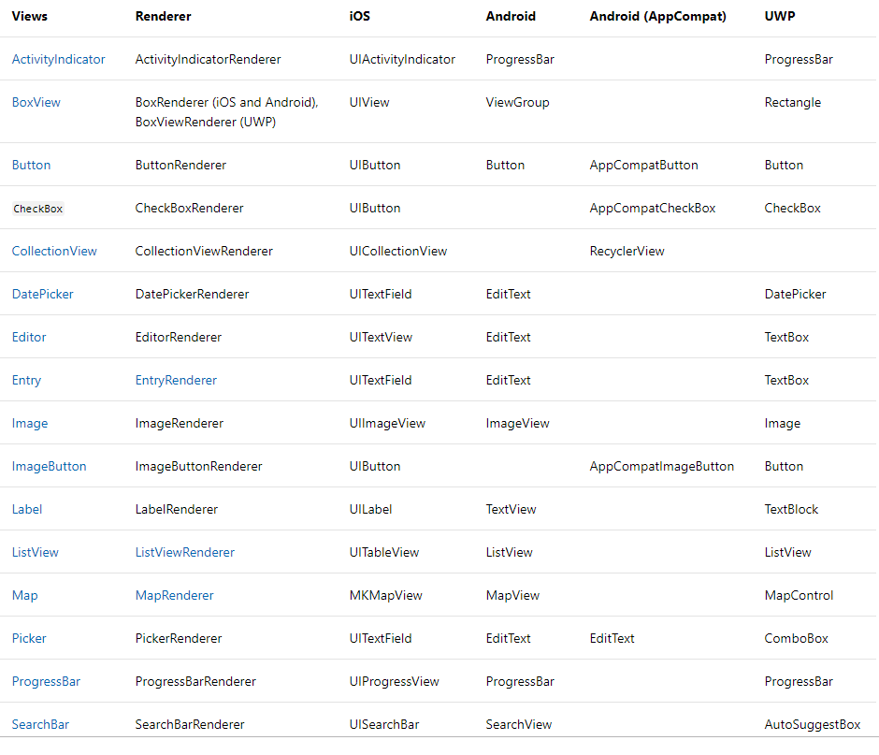
Forms UI to Native

Slide 9




Tools for Designing UI

Slide 10
DEMO

Slide 11

Questions?

